Slide 1
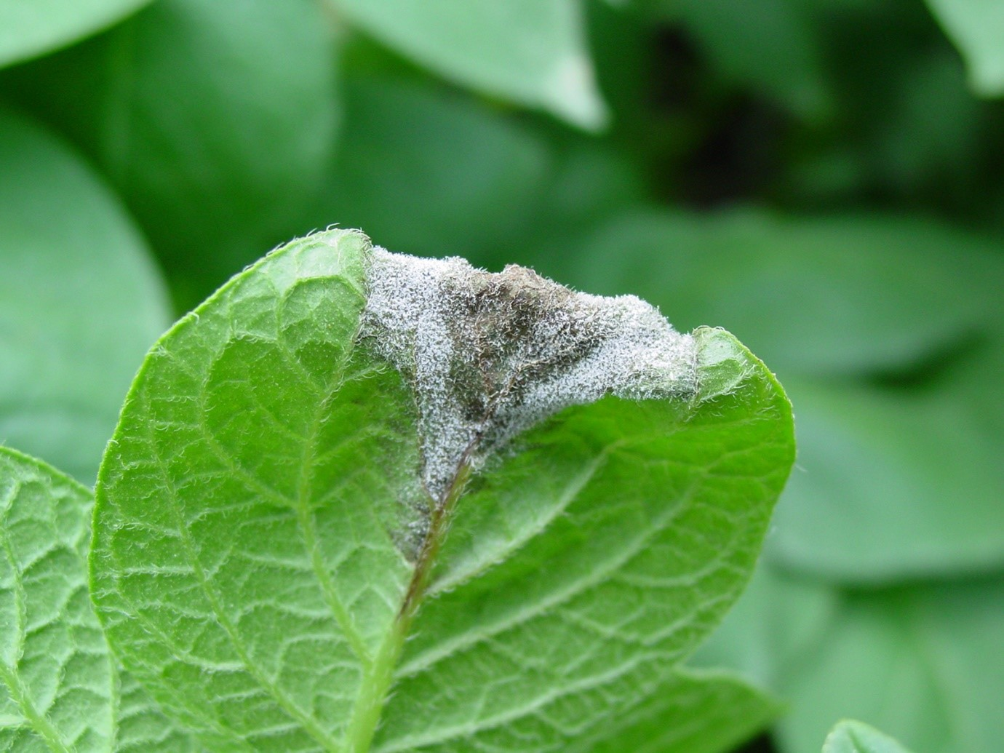
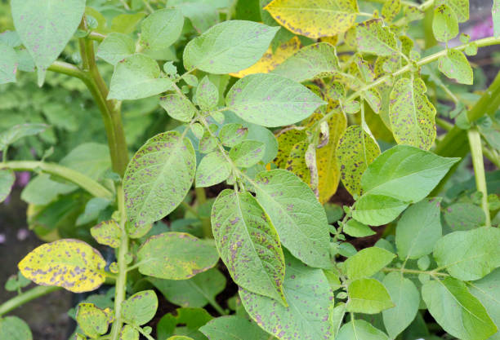
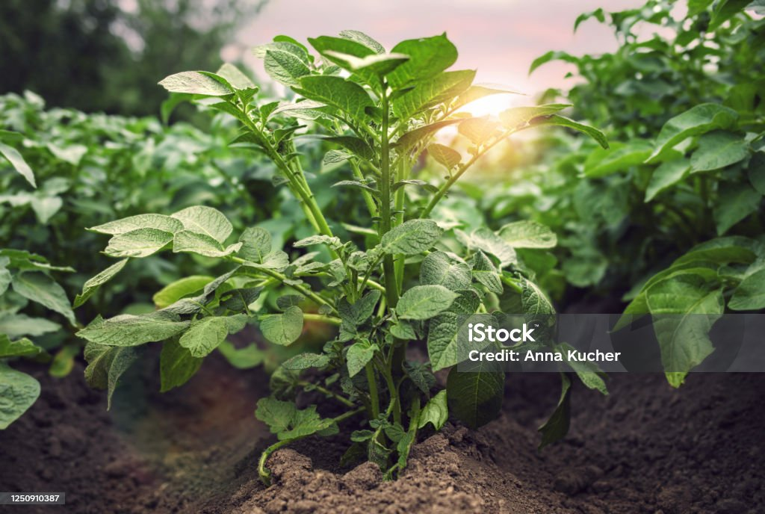
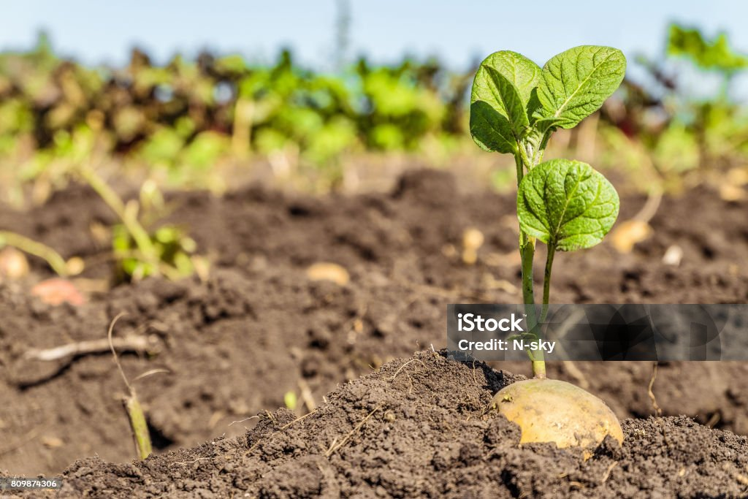

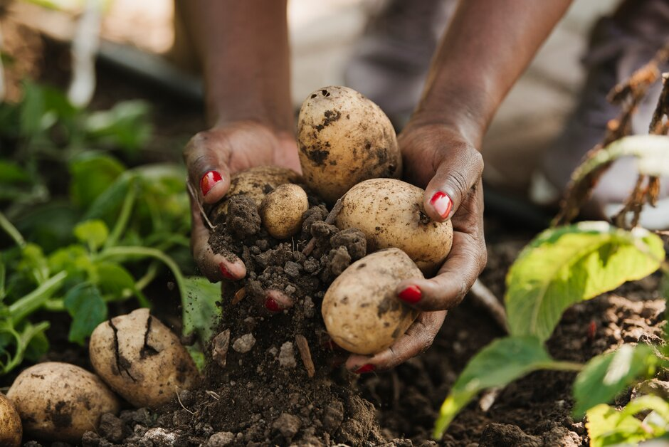
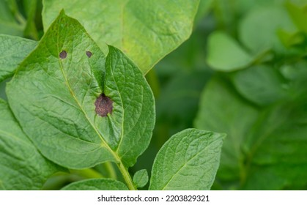
Automated Potato Disease Detection Application
GROUP – 10
Green tech innovation

Slide 2


Contents…
Introduction
Problem Statement
Aim
Objectives
Methodology
Work Plan
Conclusion

Slide 3


INTRODUTION FOR OUR APP
We will build an Android app called Dr. Potato and use take picture & drag and drop an image of a potato plant leaf and the app will tell whether the potato plant has a disease or not.
It can be given to the farmers and farmers need to do is go to the farm and just take of a picture of the plant.
the mobile application will tell them whether the plant is healthy or it has been infected with the disease and it works with image processing based deep learning and Convolutional Neural Networks (CNN)

Slide 4


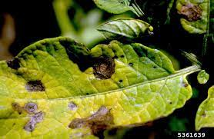
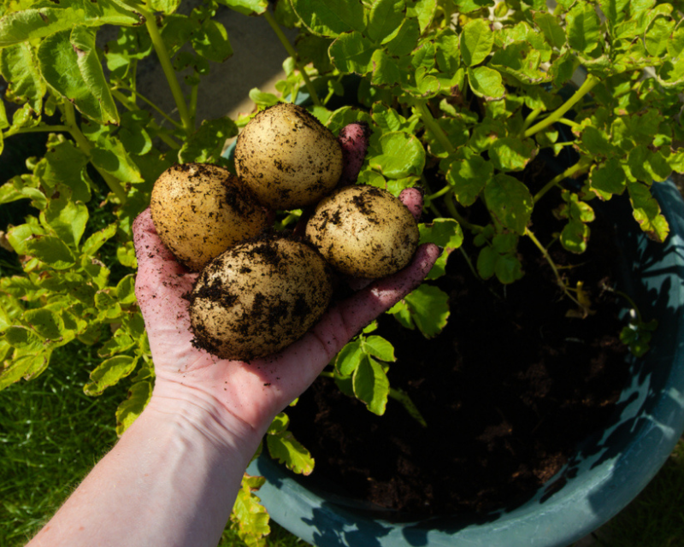
PROBLEM STATEMENT
Potato blight caused by a harmful fungus, is a major threat to global potato production, making them unsellable. Farmers sometimes use strong chemicals to fight it, which harms the environment. This can lead to fewer potatoes in stores. Current methods to deal with this disease are expensive, slow, and not always right.
So, what is the solution to address these shortcomings?
Dr. Potato Automated Potato Detection Application

Slide 5

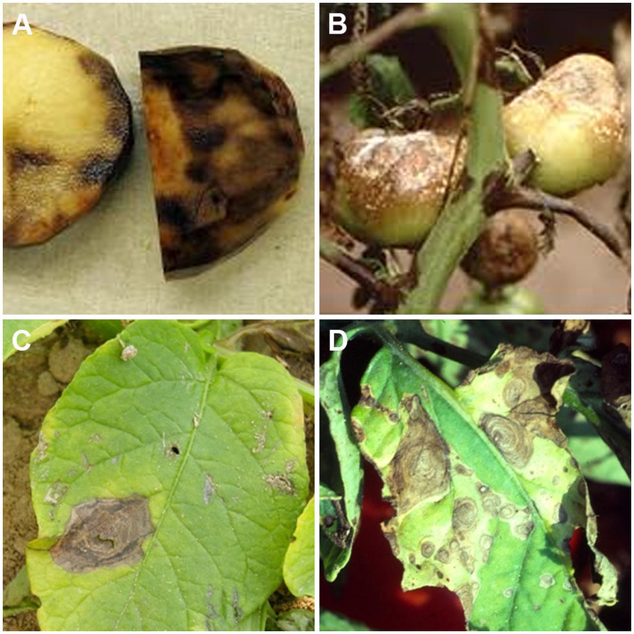
AIM
Quickly and accurately identify early & late blight in potato crops using image processing technology.
Enable early detection of disease symptoms.
Minimize crop damage.
Identify weaknesses in existing disease
detection systems.
Ensure fast access for efficient disease
management.
Implement timely control measures and
minimize crop damage

Slide 6
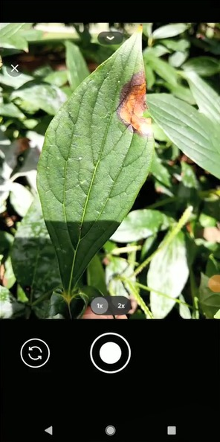
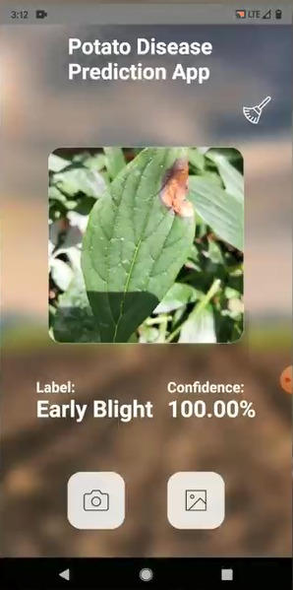

OBJECTIVES
To easily Access offering information on potato diseases and disorders in an easily accessible format-Provide a User-Friendly Interface
To identify the existing system and identify its weaknesses
-Data collection: use ready-made data from Kaggle.
To train that data set-Building and training a Convolutional Neural Network (CNN) model.
To develop a connection between the model and UI & access that data-develop a fast API server around that model.
To deploy the production -will have to develop a working HTTP server
To fast access and edit capabilities-deploy the Model in Google Cloud and GCP

Slide 7
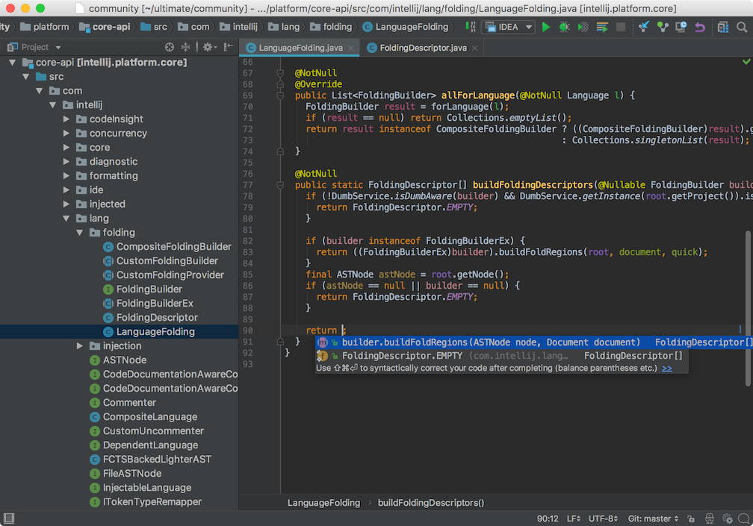
METHODOLOGY
Problem Definition and Objective Setting
Literature Review
Requirement Analysis
System Design
Develop
Testing and Optimization
Documentation

Slide 8


METHODOLOGIES AND DEVELOP
Data collection & Pre-processing
Model Building & Model training
Export model
Model Building
TensorFlow
CNN
Data augmentation
tf dataset
Convert tf lite model
Frontend & Deployment
React Native
Deployment to GCP
Connect backend and Deployment
Front end develop
Deploy Google cloud
Model Optimization
Quantization
TensorFlow Lite
Backend server
TensorFlow

Slide 9
CONCLUTION
Our project helps farmers detect and manage potato diseases better.
By using technology and easy interfaces, we make it easier for farmers to protect their crops.
Working with farmers and experts, we're making potato farming more resilient in Sri Lanka.

Slide 10

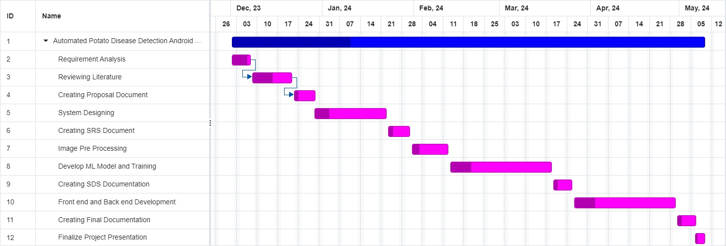
WORK PLAN

Slide 11
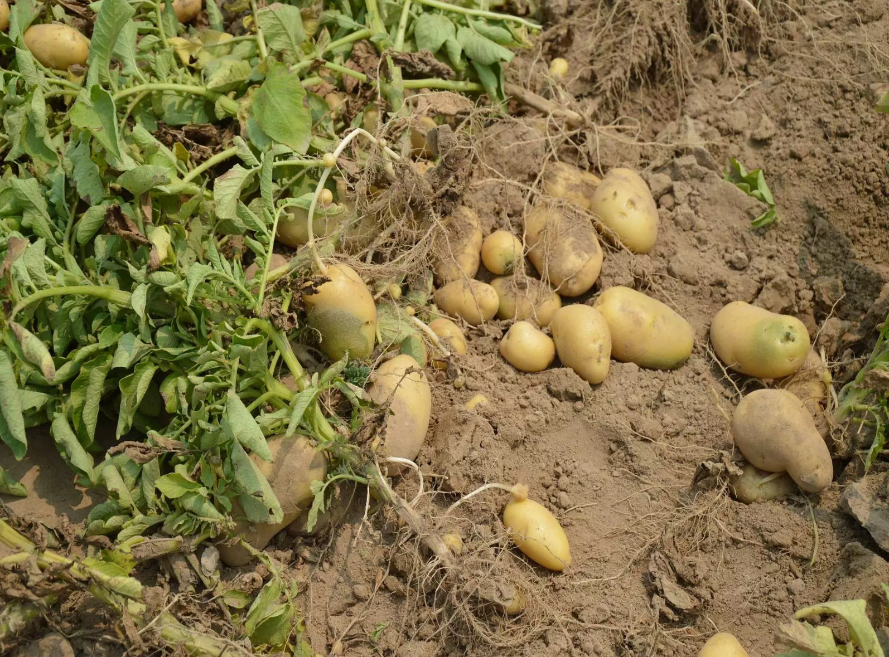
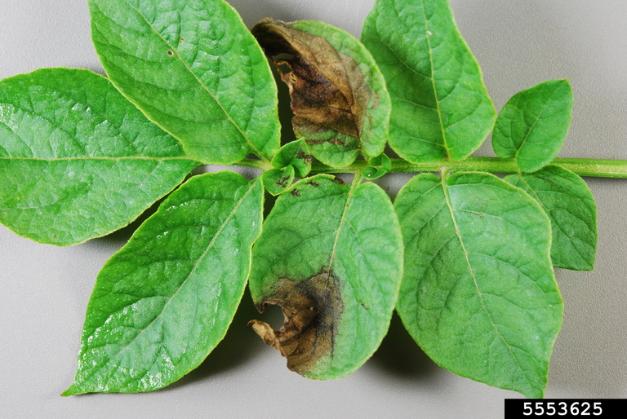
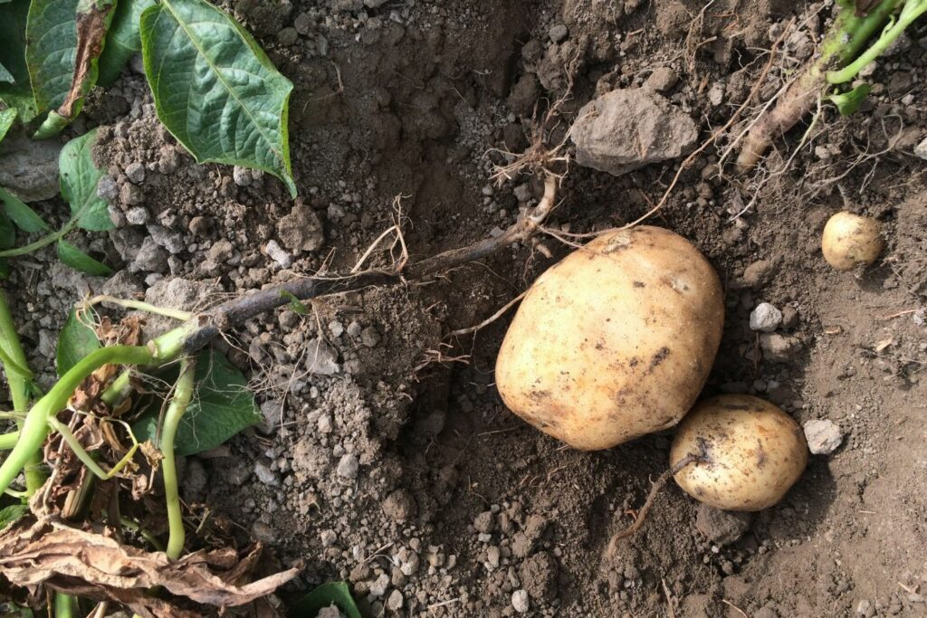

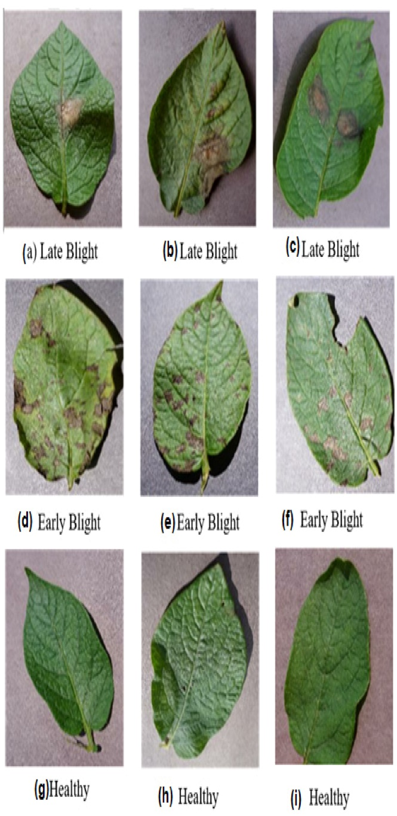

OUR TEAMATES
T.P. Gajasinghe 0715
S.I.A. Ahamed 0959
W.A.L.S. Ariyasena 0962
P. Dilakshika 0984
N.A.H.T. Samaranayaka 1030
S.R Sandaruwan 1031
R. Shabilojan 1037

Slide 12
THANK YOU …

